Slide 1

NAKUJA PROJECT N-2 BENCHMARKING OF ROCKET MODELS.
Benchmarking of rocket models of approx. 1km apogee.

Slide 2

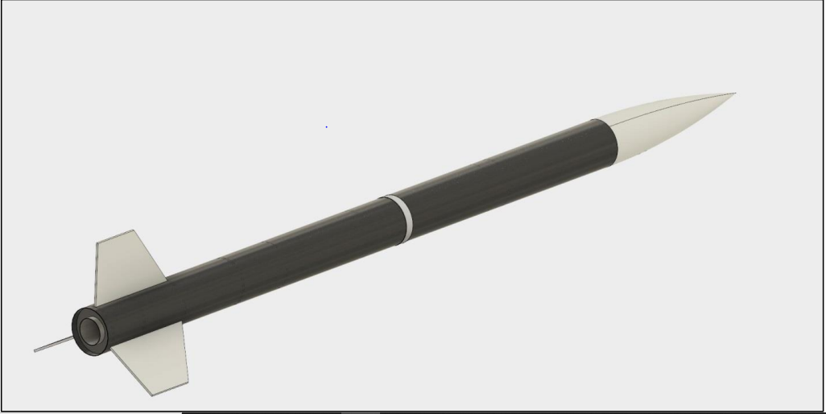
R4: university of Evansville
Altitude: 1609
SIZE AND MASS:
Length: 264
Body tube diameter: 13.97 cm
Material – Body tube: Carbon fiber
Material – Bulkhead: Aluminum
Material – Nosecone: Fiberglass
Fin surface area: 406.5 square cm
MOTOR CHOICE:
L class motor
Maximum velocity: 192.3 m/s
Max acceleration: 69.79 m/s2
PARTS:
Electronics
Main Payload
Recovery
Propulsion

Slide 3
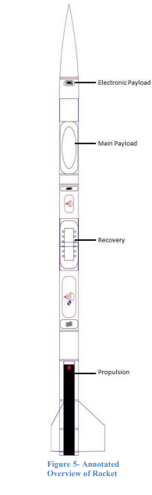
AIRFRAME:
body tube was manufactured from carbon fiber because it has a higher tensile strength, lower density, and a lower ductility compared to that of fiberglass or Blue Tube.
The bulkheads will be made of 0.635 cm aluminum. They will be milled on a 3-axis CNC mill.
The material for the fins and nosecone will be G-10 fiberglass because it can be commercially purchased at a low cost - A G-10 fiberglass sheet will be purchased and milled to the proper shape using the 3-axis CNC mill.
The clipped delta design will be used for the fins. This design offers a large surface area to stabilize the rockets while creating little drag.
HARDWARE:
Altus Metrum TeleMega: ability to track the altimeter live while the rocket is in flight. Also contains the GPS tracking device
Arrow 440-3 Yagi Antenna: receives the data sent by the TeleMega. connected to a laptop and which will record all data through open source software.

Slide 4
RECOVERY SUBSYSTEM:
70 cm drogue parachute - initial descent rate of 22.9 m/s
182.9 cm drogue parachute – impact speed of 5.76 m/s
Dual-deployment recovery system with redundant altimeters.
At apogee, a black powder ejection charge will pressurize the volume above the coupling tube, separating the rocket into two sections and deploying a small, ripstop nylon drogue parachute
At an altitude of 1000 feet, a second black powder ejection charge will pressurize the volume below the coupling tube, separating the rocket again and deploying the main parachute, also made of ripstop nylon.
All three sections of the rocket will be tethered together using lengths of tubular nylon cord and attached to the bulkheads using eyebolts.

Slide 5
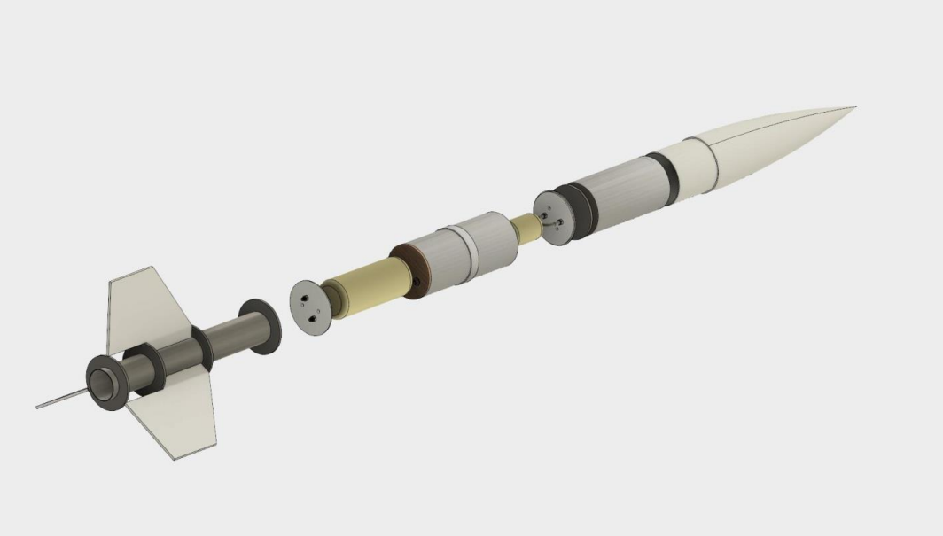
Reference: https:https://www.evansville.edu/majors/mechanicalengineering/docs/ProjectAceProposal.pdf

Slide 6

Thank You!
Ogweno Emmanuel

